Slide 1

Go, change the world
RV College of
Engineering
ARTIFICIAL INTELLIGENCE AND MACHINE LEARNING
(21AI52)
Unit 5
Department Of Information Science & Engineering

Slide 2
Unit 5
Unsupervised Learning- Overview, What Is Cluster Analysis, Different Types of Clustering’s, Different Types of Clusters
K-means-The Basic K-means Algorithm, Additional Issues, Bisecting K-means, K-means and Different Types of Clusters, Strengths and Weaknesses, K-means as an Optimization Problem
Cluster Evaluation-Overview, Unsupervised Cluster Evaluation Using Cohesion and Separation, Unsupervised Cluster Evaluation Using the Proximity Matrix, Determining the Correct Number of Clusters, Supervised Measures of Cluster Validity, Assessing the Significance of Cluster Validity Measures, Choosing a Cluster Validity Measure

Slide 3
What is Cluster Analysis?
Cluster: A collection of data objects
similar (or related) to one another within the same group
dissimilar (or unrelated) to the objects in other groups
Cluster analysis (or clustering, data segmentation, …)
Finding similarities between data according to the characteristics found in the data and grouping similar data objects into clusters
Unsupervised learning: no predefined classes (i.e., learning by observations vs. learning by examples: supervised)
Typical applications
As a stand-alone tool to get insight into data distribution
As a preprocessing step for other algorithms

Slide 4
Clustering for Data Understanding and Applications
Biology: taxonomy of living things: kingdom, phylum, class, order, family, genus and species
Information retrieval: document clustering
Land use: Identification of areas of similar land use in an earth observation database
Marketing: Help marketers discover distinct groups in their customer bases, and then use this knowledge to develop targeted marketing programs
City-planning: Identifying groups of houses according to their house type, value, and geographical location
Earth-quake studies: Observed earth quake epicenters should be clustered along continent faults
Climate: understanding earth climate, find patterns of atmospheric and ocean
Economic Science: market resarch

Slide 5
Clustering as a Preprocessing Tool (Utility)
Summarization:
Preprocessing for regression, PCA, classification, and association analysis
Compression:
Image processing: vector quantization
Finding K-nearest Neighbors
Localizing search to one or a small number of clusters
Outlier detection
Outliers are often viewed as those “far away” from any cluster

Slide 6
What is Cluster Analysis?
Finding groups of objects such that the objects in a group will be similar (or related) to one another and different from (or unrelated to) the objects in other groups
Inter-cluster distances are maximized
Intra-cluster distances are minimized

Slide 7
Quality: What Is Good Clustering?
A good clustering method will produce high quality clusters with
high intra-class similarity
low inter-class similarity
The quality of a clustering result depends on both the similarity measure used by the method and its implementation
The quality of a clustering method is also measured by its ability to discover some or all of the hidden patterns

Slide 8
Measure the Quality of Clustering
Dissimilarity/Similarity metric: Similarity is expressed in terms of a distance function, typically metric: d(i, j)
There is a separate “quality” function that measures the “goodness” of a cluster.
The definitions of distance functions are usually very different for interval-scaled, boolean, categorical, ordinal ratio, and vector variables.
Weights should be associated with different variables based on applications and data semantics.
It is hard to define “similar enough” or “good enough”
the answer is typically highly subjective.

Slide 9
Notion of a Cluster can be Ambiguous
How many clusters?
Six Clusters
Two Clusters
Four Clusters

Slide 10
TYPES OF DATA IN CLUSTER ANALYSIS

Slide 11
Data Structures
Data matrix
(two modes)
Dissimilarity matrix
(one mode)

Slide 12
Type of data in clustering analysis
Interval-scaled variables
Binary variables
Nominal, ordinal, and ratio variables
Variables of mixed types

Slide 13
Interval-valued variables
Standardize data
Calculate the mean absolute deviation:
where
Calculate the standardized measurement (z-score)
Using mean absolute deviation is more robust than using standard deviation

Slide 14
Similarity and Dissimilarity Between Objects
Distances are normally used to measure the similarity or dissimilarity between two data objects
Some popular ones include: Minkowski distance
where i = (x_{i1}, x_{i2}, …, x_{ip}) and j = (x_{j1}, x_{j2}, …, x_{jp}) are two
p-dimensional data objects, and q is a positive integer
If q = 1, d is Manhattan distance

Slide 15
Similarity and Dissimilarity Between Objects
If q = 2, d is Euclidean distance
Properties
d(i,j) ≥ 0
d(i,i) = 0
d(i,j) = d(j,i)
d(i,j) ≤ d(i,k) + d(k,j)
Also, one can use weighted distance, parametric Pearson product moment correlation, or other dissimilarity measures

Slide 16
Binary Variables
A contingency table for
binary data
Distance measure for symmetric binary variables:
Distance measure for asymmetric binary variables:
Jaccard coefficient (similarity measure for asymmetric binary variables):
Object j
Object i

Slide 17
Dissimilarity between Binary Variables
Example
gender is a symmetric attribute
the remaining attributes are asymmetric binary
let the values Y and P be set to 1, and the value N be set to 0

Slide 18
Nominal Variables
A generalization of the binary variable in that it can take more than 2 states, e.g., red, yellow, blue, green
Method 1: Simple matching
m: # of matches, p: total # of variables
Method 2: use a large number of binary variables
creating a new binary variable for each of the M nominal states

Slide 19
Ordinal Variables
An ordinal variable can be discrete or continuous
Order is important, e.g., rank
Can be treated like interval-scaled
replace x_{if} by their rank
map the range of each variable onto [0, 1] by replacing i-th object in the f-th variable by
compute the dissimilarity using methods for interval-scaled variables

Slide 20
Ratio-Scaled Variables
Ratio-scaled variable: a positive measurement on a nonlinear scale, approximately at exponential scale, such as Ae^{Bt} or Ae^{-Bt}
Methods:
treat them like interval-scaled variables—not a good choice! (why?—the scale can be distorted)
apply logarithmic transformation
y_{if} = log(x_{if})
treat them as continuous ordinal data treat their rank as interval-scaled

Slide 21
Variables of Mixed Types
A database may contain all the six types of variables
symmetric binary, asymmetric binary, nominal, ordinal, interval and ratio
One may use a weighted formula to combine their effects
f is binary or nominal:
d_{ij}^{(f)} = 0 if x_{if} = x_{jf} , or d_{ij}^{(f)} = 1 otherwise
f is interval-based: use the normalized distance
f is ordinal or ratio-scaled
compute ranks r_{if} and
and treat z_{if} as interval-scaled

Slide 22
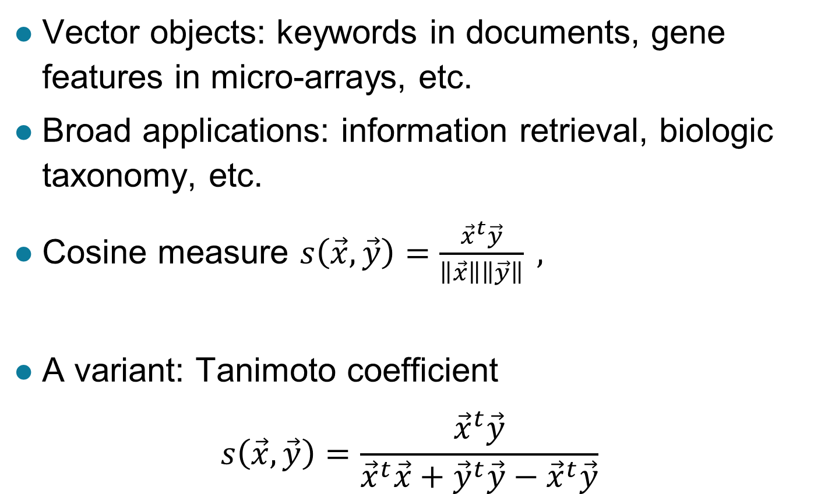
Vector Objects

Slide 23
Types of clusters

Slide 24
Types of Clusters
Well-separated clusters
Center-based clusters
Contiguous clusters
Density-based clusters
Property or Conceptual
Described by an Objective Function

Slide 25
Types of Clusters: Well-Separated
Well-Separated Clusters:
A cluster is a set of points such that any point in a cluster is closer (or more similar) to every other point in the cluster than to any point not in the cluster.
3 well-separated clusters

Slide 26
Types of Clusters: Center-Based
Center-based
A cluster is a set of objects such that an object in a cluster is closer (more similar) to the “center” of a cluster, than to the center of any other cluster
The center of a cluster is often a centroid, the average of all the points in the cluster, or a medoid, the most “representative” point of a cluster
4 center-based clusters

Slide 27
Types of Clusters: Contiguity-Based
Contiguous Cluster (Nearest neighbor or Transitive)
A cluster is a set of points such that a point in a cluster is closer (or more similar) to one or more other points in the cluster than to any point not in the cluster.
8 contiguous clusters

Slide 28
Types of Clusters: Density-Based
Density-based
A cluster is a dense region of points, which is separated by low-density regions, from other regions of high density.
Used when the clusters are irregular or intertwined, and when noise and outliers are present.
6 density-based clusters

Slide 29
Types of Clusters: Conceptual Clusters
Shared Property or Conceptual Clusters
Finds clusters that share some common property or represent a particular concept.
2 Overlapping Circles

Slide 30
Types of Clusters: Objective Function
Clusters Defined by an Objective Function
Finds clusters that minimize or maximize an objective function.
Enumerate all possible ways of dividing the points into clusters and evaluate the `goodness' of each potential set of clusters by using the given objective function. (NP Hard)
Can have global or local objectives.
Hierarchical clustering algorithms typically have local objectives
Partitional algorithms typically have global objectives

Slide 31
Types of Clusters: Objective Function …
Map the clustering problem to a different domain and solve a related problem in that domain
Proximity matrix defines a weighted graph, where the nodes are the points being clustered, and the weighted edges represent the proximities between points
Clustering is equivalent to breaking the graph into connected components, one for each cluster
Want to minimize the edge weight between clusters and maximize the edge weight within clusters

Slide 32
Considerations for Cluster Analysis
Partitioning criteria
Single level vs. hierarchical partitioning (often, multi-level hierarchical partitioning is desirable)
Separation of clusters
Exclusive (e.g., one customer belongs to only one region) vs. non-exclusive (e.g., one document may belong to more than one class)
Similarity measure
Distance-based (e.g., Euclidian, road network, vector) vs. connectivity-based (e.g., density or contiguity)
Clustering space
Full space (often when low dimensional) vs. subspaces (often in high-dimensional clustering)

Slide 33
Requirements and Challenges
Scalability
Clustering all the data instead of only on samples
Ability to deal with different types of attributes
Numerical, binary, categorical, ordinal, linked, and mixture of these
Constraint-based clustering
User may give inputs on constraints
Use domain knowledge to determine input parameters
Interpretability and usability
Others
Discovery of clusters with arbitrary shape
Ability to deal with noisy data
Incremental clustering and insensitivity to input order
High dimensionality

Slide 34
Major Clustering Approaches (I)
Partitioning approach:
Construct various partitions and then evaluate them by some criterion, e.g., minimizing the sum of square errors
Typical methods: k-means, k-medoids, CLARANS
Hierarchical approach:
Create a hierarchical decomposition of the set of data (or objects) using some criterion
Typical methods: Diana, Agnes, BIRCH, CAMELEON
Density-based approach:
Based on connectivity and density functions
Typical methods: DBSACN, OPTICS, DenClue
Grid-based approach:
based on a multiple-level granularity structure
Typical methods: STING, WaveCluster, CLIQUE

Slide 35
Major Clustering Approaches (II)
Model-based:
A model is hypothesized for each of the clusters and tries to find the best fit of that model to each other
Typical methods: EM, SOM, COBWEB
Frequent pattern-based:
Based on the analysis of frequent patterns
Typical methods: p-Cluster
User-guided or constraint-based:
Clustering by considering user-specified or application-specific constraints
Typical methods: COD (obstacles), constrained clustering
Link-based clustering:
Objects are often linked together in various ways
Massive links can be used to cluster objects: SimRank, LinkClus

Slide 36
Partitional Clustering
Original Points
A Partitional Clustering

Slide 37
Hierarchical Clustering
Traditional Hierarchical Clustering
Traditional Dendrogram
Non-traditional Hierarchical Clustering
Non-traditional Dendrogram

Slide 38
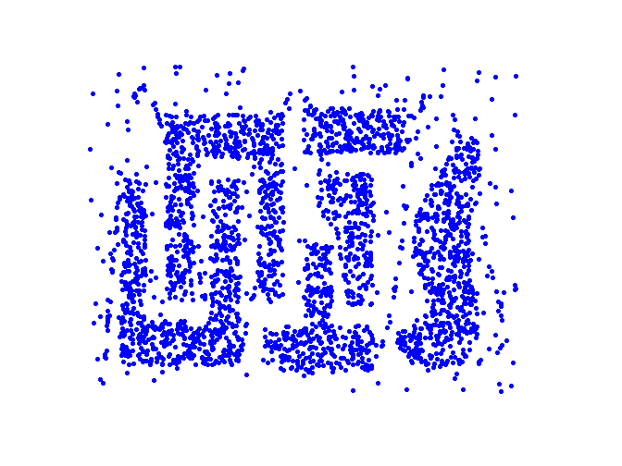
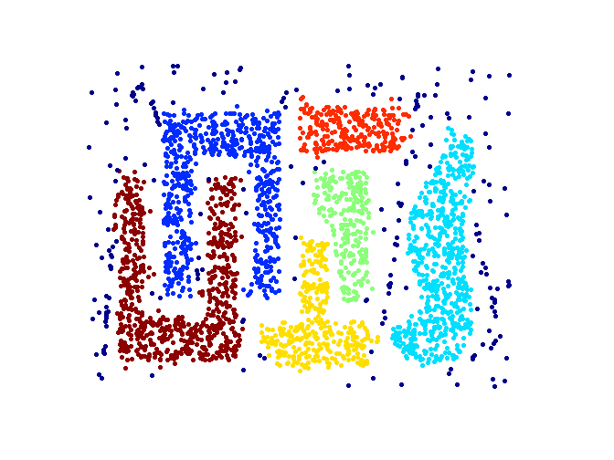
Density based Clustering
Original Points
Clusters

